Slide 1

AIRBREAKS - EAGLE
January 2026

Slide 2

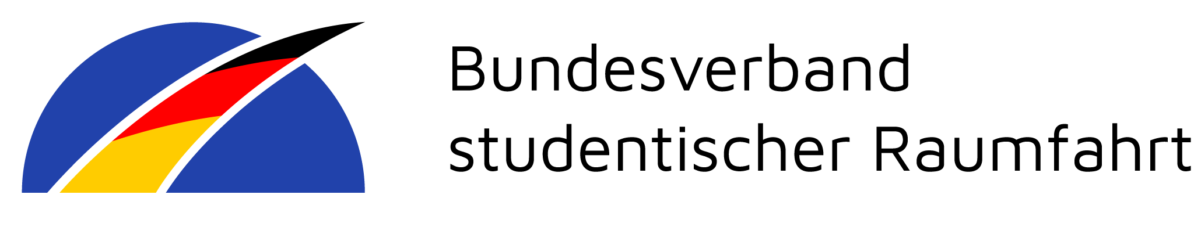
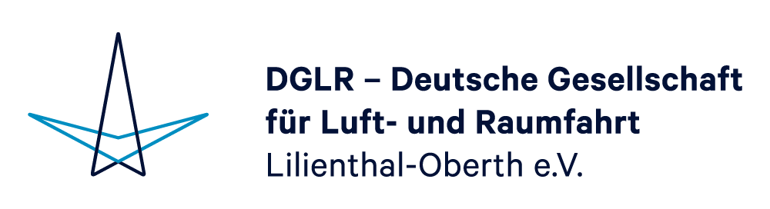
Table of contents
Motivation
Requirements
Airbreaks v1
Airbreaks v2
Overview
Cost approximation
Current concerns
Prospects
Alle Rechte vorbehalten – Jason Gläser
2/13

Slide 3
Motivation
More point for more accuarate target altitude
Simulations and motor performance inaccurate and variable
Practically no chance of accurate altitude without active control
Platform to learn basics of aerodynamics and GNC (Guidance, Navigation and Control)
  CFD-, FEM-, Flightsimulations and control engineering
Possibility to learn industry practices in GNC and aerodynamics (Grid fins, without grid ☺)
  Design in collaboration with experts from Rocket Factory Augsburg (purely private cooperation so far, NO club involvement)
Advance technology can increase chance of admission to EUROC
Alle Rechte vorbehalten – Jason Gläser
3/13

Slide 4
Requirements
Symmetrical behaviour under nominal function and defects
  Control using a single servo motor in the center
    Only requires one PWM-Signal -> 3 cabel connections in segment
    If Servo fails, every flap fails
    Simulations will show the required servo torque
      Rest of outer structure needed for simulations
Non-linear change of effective aerodynamic area
  More complex and mechanism closer to grid fins possible
    Bigger learning curve
Seperate segment
Purely mechanical parts (no hydraulics or pneumatics)
(Mechanical/Eletrical) Locking-Mechanisms of flaps
  Prevent actuation of flaps before certain altitude
    Part of EUROC‘s rules and requirements
Resting position of 0° (to body tube)
  Max. position of 90°
Alle Rechte vorbehalten – Jason Gläser
4/13

Slide 5
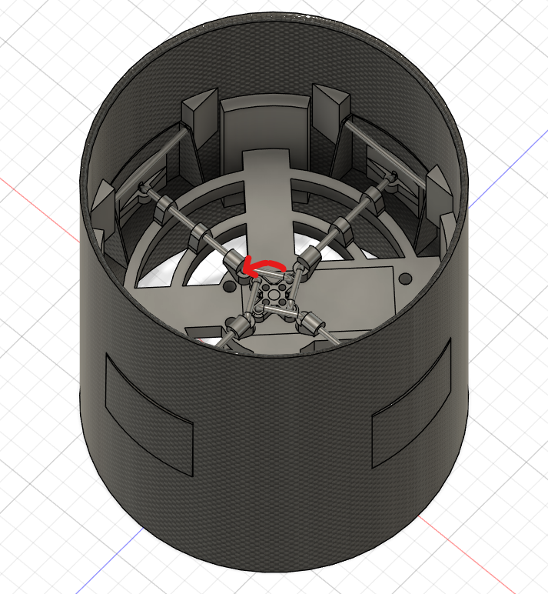
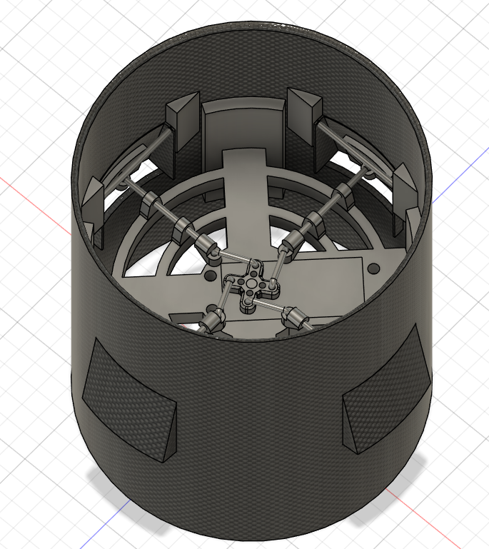
Airbreaks v1 (1/2)
Created together with Vincent
Uses same working principal as piston
Components are glued to the inside of the body tube
A lot of component are assembeled before being glued in
Advantages:
Low complexity
No fasteners needed for assembly
Mostly 3d-printable
Disadvantages:
Not really repairable
  If glue gets into moving parts everything has to be „destroyed“
  Glue has proven to be inconsistent with 3D-printed surfaces
Limited actuation distance
  Low drag range
Potentially metal on metal grinding
Large cutouts in CFK body tube with small effective area
  VERY bad -> probably would have structural issues
Body tube can probably not be produced by ourselves
Airbreaks v1 closed
Airbreaks v1 extended
Alle Rechte vorbehalten – Jason Gläser
5/13

Slide 6
Airbreaks v1 (2/2)
Bill of materials:
1x Airbreaksegment (20 cm CFK body tube)
1x Airbreak servo mount (large middle piece)
1x Servo (including for mounting screws)
1x Servo cross
4x Connecting-rod (small rod that connects to servo cross)
8x Pushing-rod bearing
4x Pushing-rod
4x Joint adapter (connecting pushing and connecting rod)
8x Hinge bearing (connector point for hinge-rod)
4x Flaps
4x Hinge-rod
4x Pushing-rod mount (connector on the inside of flap)
Alle Rechte vorbehalten – Jason Gläser
6/13

Slide 7
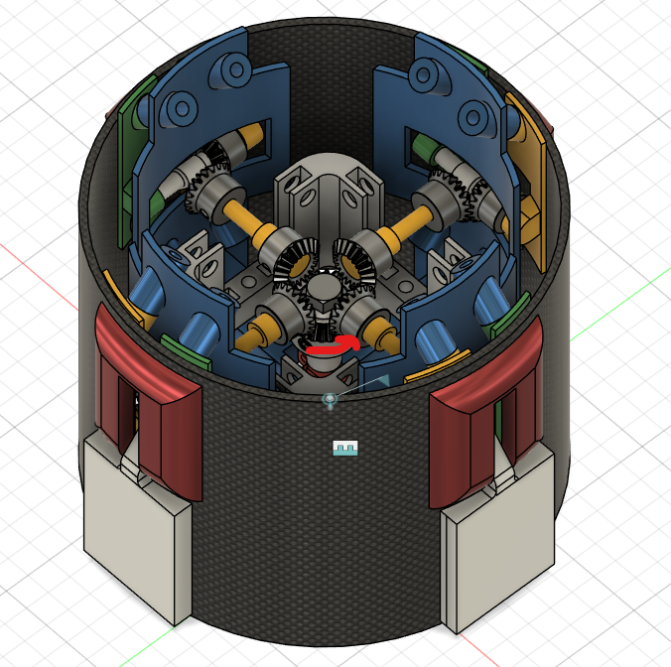
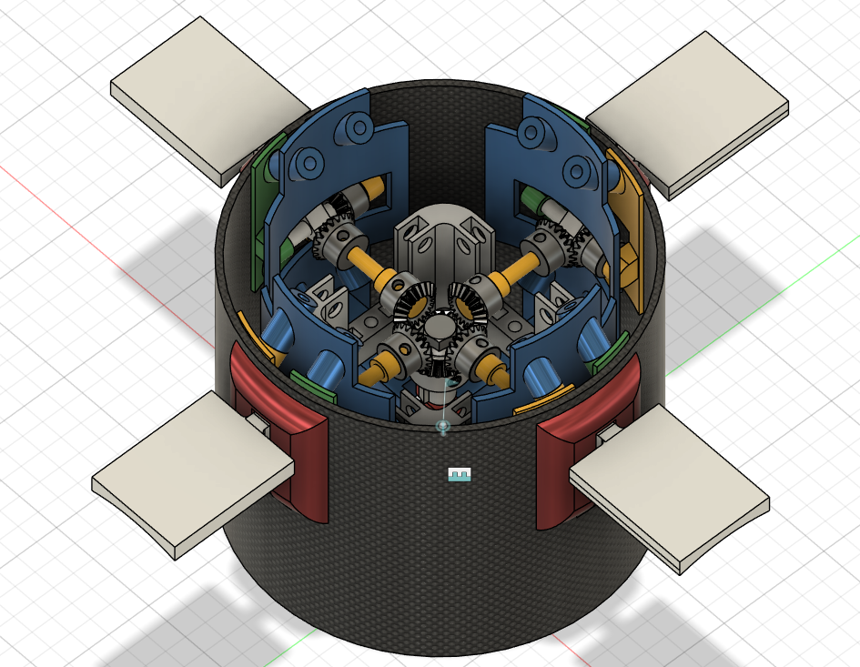
Airbreaks v2 (1/2)
Only employs gears for mechanism
Can fully be taken apart and reassembeled by losening fasteners/screws
Inner structure connects to connector rings
  Reduces load on compromised CFK tube
Flap size is NOT final
Advantages:
Extendable to 90°
Drastically reduces cutouts in body tube
Moving parts are more sustainable to high loads
  Bigger diameters etc.
Had dedicated inner structural element
Can be assembeled and disambeled if needed
Aerocovers can be used for down-facing cameras
Disadvantages:
More complex
More parts
Most parts need to be manufactured and made out of metal
Requires parts outside of body tube
Airbreaks v2 closed
Airbreaks v2 fully extended
Alle Rechte vorbehalten – Jason Gläser
7/13

Slide 8
Airbreaks v2 (2/2)
Bill of materials:
1x Servo
1x CFK body tube (20 cm)
1x Inner supporting structure (blue part)
  Main frame machined out of aluminum
4x Right hinge (green part)
  Can maybe be printed
4x Left hinge (yellow part on inner wall)
  Can maybe be printed
4x Transmission rod (yellow rod)
  Machined out of aluminum
4x Aerodynamical cover (red part)
  Can maybe be printed
4x Flaps (white part)
  Machined out of aluminum
12x Miter gear (maybe helical)
  COTS
1x Bigger Miter gear
  COTS
4x ball bearings (not in CAD-model)
  COTS
Screws and fasteners
  COTS
Alle Rechte vorbehalten – Jason Gläser
8/13

Slide 9
Overview
Minimum Height (without ring connection): 150 mm
Assumed wall strength: 3 mm
Aprox. Weight: 1.7 kg
  Depending on how much is machined
Max. flap area: 27 cm²
Amount of parts (excluding screws): 40 components
  Max. 21 need machining (6 seperate component types) -> might only be 3
  Pushing rod can be manufactured at THM (very simple part)
Range of motion (in regards to body tube): 0-90°
Electrical connections: 3 (1x PWM, 1x GND, 1x VCC)
Power consumption (max): 8.2 V (2.5 A), 20.5 W
Alle Rechte vorbehalten – Jason Gläser
9/13

Slide 10
Cost approximation
Part | Quantity (min.) | Total Price (worst case*) | Source
Servo | 1 | 69 € (UVP) | MKS Servo-tech (manufacturer)
CFK body tube | 1 | N/A | Structures team
Supporting structure | 1 | ~156 € | JLCCNC
Hinges** | 8 | ~212 € | JLCCNC
Transmission Rod** | 4 | ~61 € | JLCCNC
Aero cover** | 4 | ~83 € | JLCCNC
Flaps | 4 | ~106 € | JLCCNC
Miter gears | 13 | ~340 € | McMaster-Carr
Bearings | 4 | ~20 € | Kugellager-Express
Fasteners and Screws | N/A | ~20 € | N/A
Total cost (max.) | 1067 € | Total cost (min.) | 711 €
Cost can be drastically reduced either by CNC sponsorship or bearing sponsorship -> CNC: JLCCNC, PCBWay or similar
*Worst case assuming all parts are machined
**Could be 3D-printed or have a 3d print covered metal core
Alle Rechte vorbehalten – Jason Gläser
10/12

Slide 11
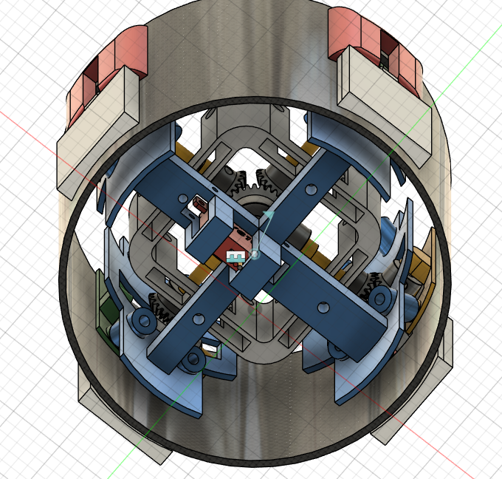
Current concerns
  Does everything fit in real life?
  Structural integrity of body tube due to cutouts and holes
  Connection to connector ring
  Weight
    Is generative design applicable in our case?
      Can drastically reduce weight, but costs more in manufacturing
        Load simulations needed first
  Can gears sustain load
  Are simulations possible within the time frame?
    Dependened on a full outer structure
  How can we evaluate simulations in real life?
  Flap size
    Simulations needed
      Full rocket model needed
  Reliable and symmetrical locking-mechanism
Alle Rechte vorbehalten – Jason Gläser
11/13

Slide 12
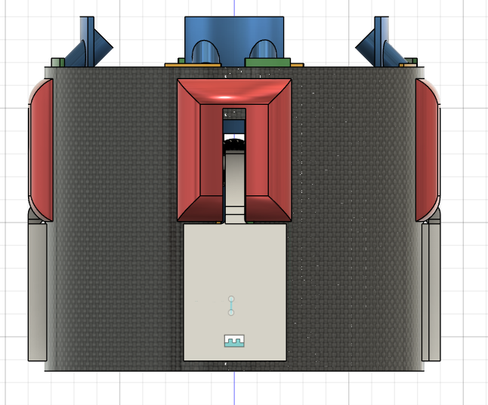
Prospects
  Optimisation for weight
  First simulations in Q1 2026
  Test fit with 3D-printed parts in January 2026
  (Reduce complexity and amount of parts)
  Further reduce body tube cutouts (long term)
  Design review with RFA in February 2026
  Electrical design in Q1 2026
Alle Rechte vorbehalten – Jason Gläser
12/13

Slide 13







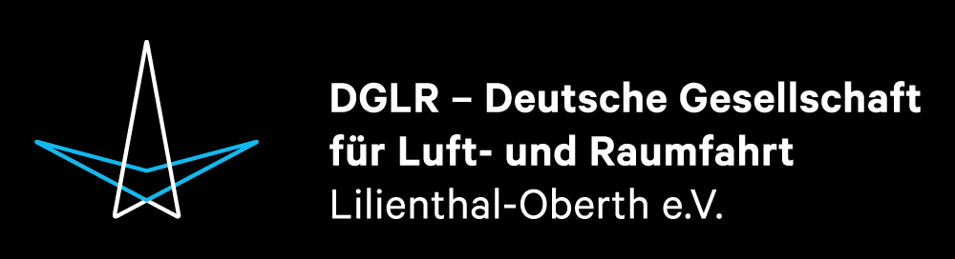
Kontaktiert uns gerne jederzeit bei Fragen oder falls ihr weitere Informationen erhalten wollt per Insta, unserer Website oder gerne auch per Mail.
raketenbau@fb07.uni-giessen.de
spaceflight-rocketry-giessen.de
Vielen
Dank!
sprog.ev
Notes:
Es ist zwar offiziell nichts geplant worden, aber man trotzdem noch nach Lust und Laune spontan in ne Kneipe gehen

